Slide 1
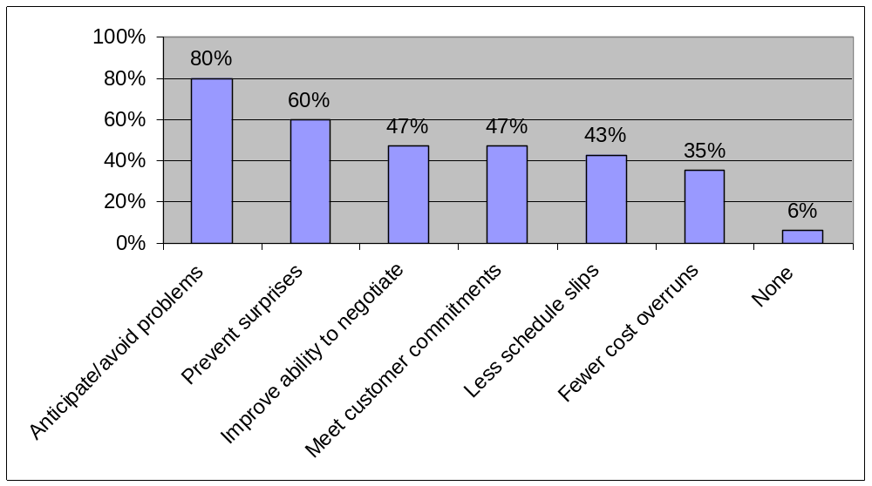
Figure 11-1. Benefits from Software Risk Management Practices

Slide 2
Risk Breakdown Structure for Project Name
Prepared by:
Date:
IT Project
Business
Technical
Organizational
Project Management
Competitors
Hardware
Executive support
Estimates
Suppliers
Software
User support
Communication
Cash flow
Network
Team support
Resources

Slide 3
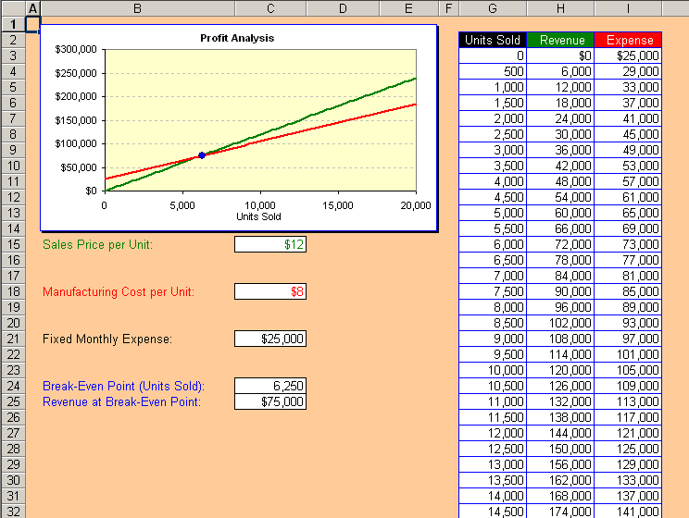
Sensitivity Analysis to Determine Breakeven

